Slide 1
Observational Studies I
Nora Kalagi, MSc., PhD
Yasser Albogami, MPH., PhD
PHCL 435
September 2023

Slide 2

Outline
What is Observational Study Design?
Types of Observational Study Design
Advantages of Observational Studies
Disadvantages of Observational Studies
Descriptive vs. analytical studies

Slide 3
Objectives
At the end of the lecture, the students will be able to:
Identify the general purposes of research
Discuss the important principles of study design
Distinguish between experimental, quasi-experimental, and observational approaches
Describe various observational study designs
Discuss the relative advantages and disadvantages of the various study designs

Slide 4
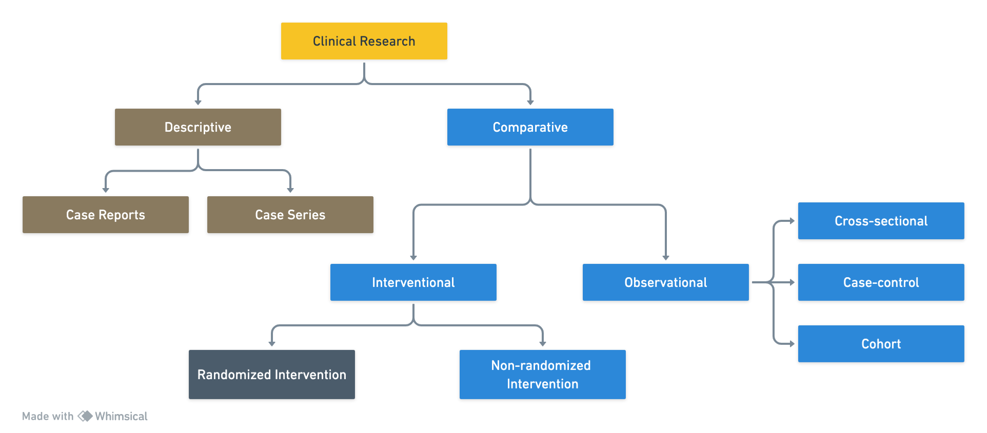
Clinical Research Types

Slide 5
In most situations well designed studies are needed to aid in clinical decision making
Example of past errors

Slide 6
Comparative Clinical Research Descriptive Studies

Slide 7
Clinical Research Types

Slide 8
Case Report
Reports of events observed in a single patient
It is very rare that a case report can be used to make a statement about causation

Slide 9
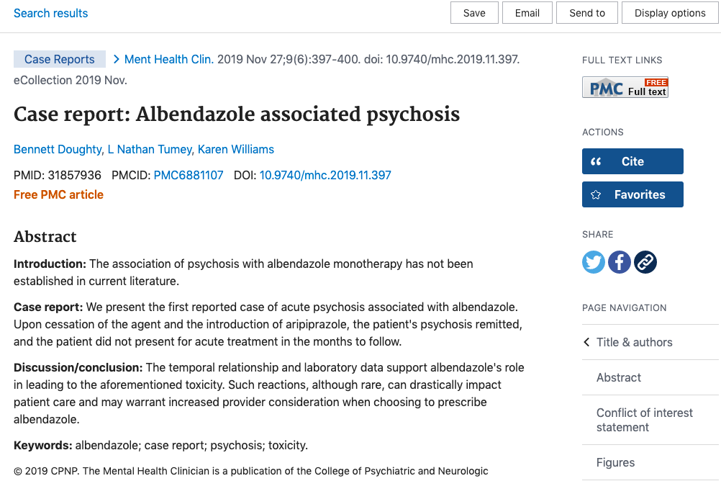
Case Report

Slide 10
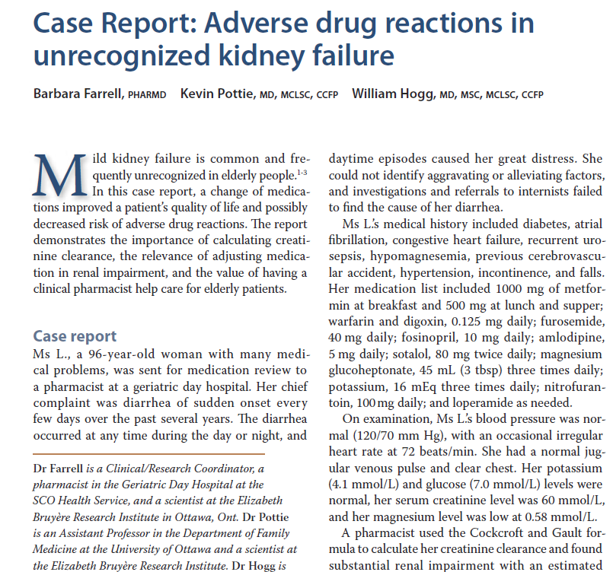
Case Report

Slide 11
Case Series
A type of medical research study that tracks subjects with a known exposure (e.g. patients who received similar treatment), or examines their medical records for exposure and outcome
Following the clinical course of a particular condition in a group of individuals
A case-series aggregates individual cases in one report
Often, they are from a single hospital or medical practice

Slide 12
Case Series
Example: Mumps vaccine and aseptic meningitis
Exposure: vaccination with a live mumps vaccine Urabe strain.
Outcome: aseptic meningitis
One study, involving only 10 cases, was conducted in 1992 in Oxford, UK
All Urabe mumps vaccines were subsequently replaced by vaccines based on other strain

Slide 13
Case Series
Example: Retinal toxicity due to canthaxanthin.
Exposure: Canthaxanthin apply to skin for tanning.
Outcome: Retinopathy.
One study, involving only Two female patients, one 42 years-old and the other 72 years-old, with signs of retinopathy due to canthaxanthin.

Slide 14
Advantages & Disadvantage
Advantages | Can be published quickly Easy to do (fast and no financial support needed) Identify rare manifestations of a disease or drug
Disadvantages | May include researcher bias Difficult to replicate Can't always be generalised to the broader population (lack of generalizability)

Slide 15
Question (1)
Case series are defined as single reports on one individual patient, while case report are collections of information on more than one patient.
T
F

Slide 16
Comparative Clinical Research Observational Studies
Cross-Sectional Studies

Slide 17
Clinical Research Types

Slide 18
What is a Cross-Sectional Study?
A cross-sectional study is a type of observational study that looks at data collected from a population at a specific point in time.
It is used to examine relationships between variables and to assess the prevalence of a particular characteristic or condition in a population at a given point in time or over a short period of time.
Sampling strategies
Entire population of interest
Exposure groups
Disease groups

Slide 19
Cross- Sectional Studies
It is often used to compare the characteristics of different groups or to measure changes over time.
It is also used to identify risk factors for a particular condition or to measure the effectiveness of a particular intervention.
Unlike the other epidemiologic study designs, the outcome of interest and the exposure of interest are determined simultaneously.

Slide 20
Cross-Sectional Studies
Measure disease status on all subjects
Measure exposure status on all subjects
Compares exposure status with disease status without establishing temporality between them.
A “snapshot”

Slide 21
Cross-Sectional Studies- Examples
If coffee associated with sleep disturbance?
Is rate of medication adherence associated with depression?
Factors associated with adherence to ACS guidelines

Slide 22
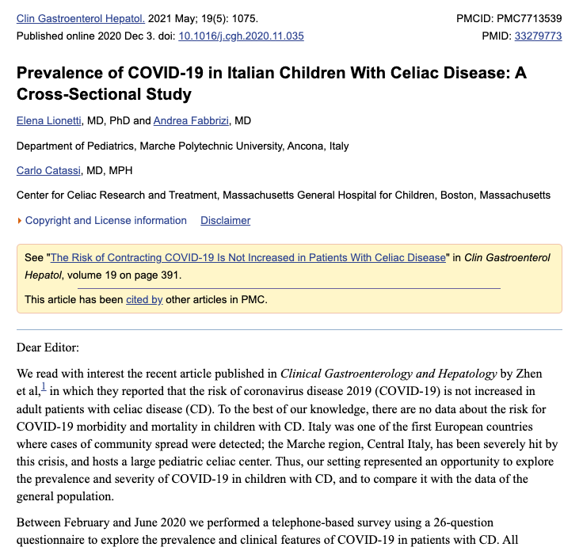
Example of Cross-Sectional study

Slide 23
Cross-Sectional Studies- How Good Are They?
Advantages:
Less expensive
Potentially can detect potential effect of exposures that do not vary over time
Hypothesis generation
Estimation of the magnitude of a health problem
Disadvantages:
Temporal relationship is not clear
Prevalent cases may be over-represented by cases with long disease duration
Cannot measure disease incidence

Slide 24
Question (3)
Cross-sectional study is a snapshot of group of people at a given point in time.
T
F

Slide 25
Clinical Research Types

Slide 26
Comparative Clinical Research Observational Studies
Case- Control Studies

Slide 27
Case-Control Studies
CC studies compare:
People with the disease (cases) to people without the disease (controls) with respect to exposures or characteristics of interest

Slide 28
Case-Control Studies
Aims to identify factors that could be responsible for the development of a disease or drug use problem
Case-control studies are retrospective and cannot therefore be used to calculate the relative risk (RR)
However, odds ratio (OR) can be calculated, which usually approximates to the relative risk when the outcome of interest is rare.

Slide 29
Case-Control Studies
Motivation:
Prospective cohort study may require long period of follow-up
Rare disease
Data may not exist for retrospective cohort study

Slide 30
Case-Control Studies
Backward Directionality
Exposure
Outcome/Disease
Time
Yes
?
No
?

Slide 31
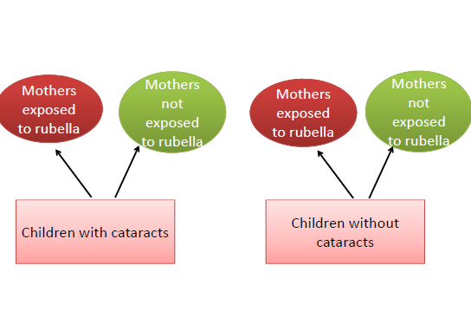
Case-Control Studies

Slide 32
Question (4)
A case control study is a type of observational study is useful to look at factors associated with rare outcomes
T
F

Slide 33
Case-Control Studies
Much quicker and cheaper than cohort study
Potential good starting point for scientific inquiry
Biggest challenge:
Who to select as controls?

Slide 34
Basic Steps of Case-Control Studies
Formulation of the research questions
Identification and collection of cases
Selection of controls and matching
Determination of exposure in all subjects
Collection, analysis, and interpretation of data

Slide 35
Selection of Cases and Controls
Cases
Have disease of interest
Controls
Do not have disease of interest

Slide 36
Case Selection
Case definition: specifying criteria to identify a person as a case
Diagnostic criteria
Inclusion (eligibility)/ exclusion criteria
Incident/prevalent
Cases source: define source population
Registries
Hospitals, medical facilities, physicians' office

Slide 37
Ideal Control Group
The purpose of controls is to measure the frequency of exposure in the source population that produced the cases
Cases
Asthma
Own pets?
Controls: no-Asthma

Slide 38
Ideal Control Group
Probability of sampling any “exposed” person as a control should be proportional to the number of exposed people in the source population

Slide 39
Ideal Control Group
To achieve this ideal (these are equivalent):
Controls should be drawn from the source population that produced the cases
Controls much be sampled independently of their exposure status
Controls should be those who, if they had developed the outcome, would have been sampled in your study as a case.

Slide 40
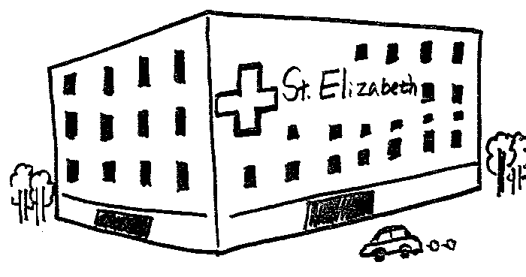
Good Selection of Controls
Cases:
or
?
Controls
Source Population:
50% own pets, 50% do not own pets

Slide 41
Sources of Control Group
Same community
Patients in the same hospital
Individuals who reside in the same neighborhood
Siblings, or associates of the cases

Slide 42
Sources of Controls: Hospitalized Patients
When cases are hospital-recruited, source population is the catchment population of the hospital
Catchment population: all the people who would have been identified as cases if they had developed the disease.
One approach is to select controls who have a different illness and are treated at the same hospital, also known as hospital, clinic, or diseased controls.

Slide 43
Sources of Controls: Hospitalized Patients
Advantages:
Convenient and relatively inexpensive
Cases and controls are likely to be similar in their accuracy of recall
Generally high level of cooperation of subjects
Disadvantages: (both selection bias scenarios):
Disease for which controls are hospitalized may be associated with exposures under study
Selection factors that lead to hospitalization may differ between cases and controls (referral patterns)

Slide 44
Case-Control Analysis
Use an odds ratio to compare the frequency
of exposure in cases vs. controls
Controls
Cases

Slide 45
2x2 Tables
 | Disease Status
Exposure Status | Positive | Negative
Exposed | a | b
Unexposed | c | d
Total exposed = a + b Total unexposed = c + d
Total with disease = a + c
Total without disease = b + d

Slide 46
Odds
Exposure odds in those with disease
Probability=a/(a+c)
Odds
= [a/(a + c)] / [1 - [a/(a + c)] ]
= [a/(a + c)] / [c/(a + c)]
= a/c
Exposure odds in those without disease
Probability=b/(b + d)
Odds=[b/(b + d)] / [d/(b + d)]
= b/d
 | D+ | D-
E+ | a | b
E- | c | d

Slide 47
Odds Ratio
Odds that a case was exposed / the odds that a control was exposed
= (a/c) / (b/d)
= (a/c) * (d/b)
= ad / bc = cross-product
 | D+ | D-
E+ | a | b
E- | c | d

Slide 48
Interpretation of OR
“Benzodiazepine ever use was associated with an increased risk of Alzheimer's disease (adjusted odds ratio 1.51, 95% confidence interval 1.36 to 1.69)”
Interpretations
AD is associated with a 1.51-times increase in the odds of Benzodiazepene use
Benzodiazepene use is associated with a 1.51-times increase in the odds of AD

Slide 49
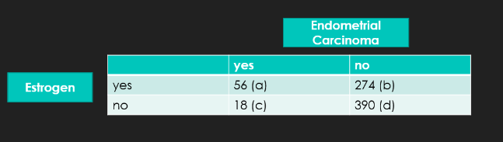
Question (5)
In a study examining the association between estrogen (exposure) and endometrial carcinoma (outcome):
The OR = 4.4
What does that mean?
Notes:
individuals with endometrial cancer are 4.42 times more likely to be exposed to estrogen than those without endometrial carcinoma.

Slide 50
Case-Control Studies- Example
CHD CHD
(+) (-)
Hypertension (cases) (controls)
Present 150 225
Absent 100 275
Total 250 500
Analysis:
% with hypertension 60% 45%
Issues of Concern:
Definition of CHD and use of incident vs prevalent cases
Definition and measurement of hypertension
Role of other potential confounders and issues of matching vs
regression modeling

Slide 51
Question (6)
When you are investigating something that is socially unacceptable, for example, IV drug use, that’s potentially can lead to ……………. bias.
Recall
Notes:
Recall bias

Slide 52

Collecting Data in Case-Control Studies
Data must be collected on prior exposure to risk factor of interest
Information about a variety of exposures may be collected to look for associations with the disease or drug use
Source of Data:
Interviews and questionnaires are the most common means of determining a subject's exposure history
Medical records review
Biological marker

Slide 53
Matching in Case-Control Studies
Purpose:
Helps to ensure that cases and controls are similar with respect to important risk factors
To control for confounding or selection bias
More than one control can be matched to each case, but the ratio of controls to cases rarely exceeds 4:1
Example: race, gender , age, etc…

Slide 54
Matching Cases and Controls
Pluses
Drawback
Increase the statistical efficiency of case-control comparisons
Simplifies decisions about how to sample controls
It ensures that case-control differences in the risk factor of interest cannot be explained by reference to the matched variables.
Time consuming and expensive
Potential cases and controls may be excluded because matches cannot be made
Matched variables cannot be evaluated as risk factors in the study population

Slide 55
Case-Control Studies- How Good Are They?
Advantages:
Saves time and money
Efficient way to deal with long induction period
Ideal when outcome is rare
Allows evaluation of multiple exposures for single disease
Disadvantages:
Accurate data on exposure may be difficult to obtain
Inefficient with rare exposures
Greater potential for bias when disease status is known when assessing exposure status
Selection of controls

Slide 56
THANK YOU
Questions

